Slide 1
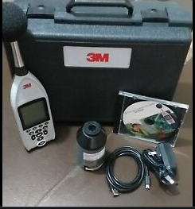




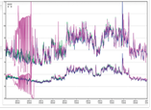


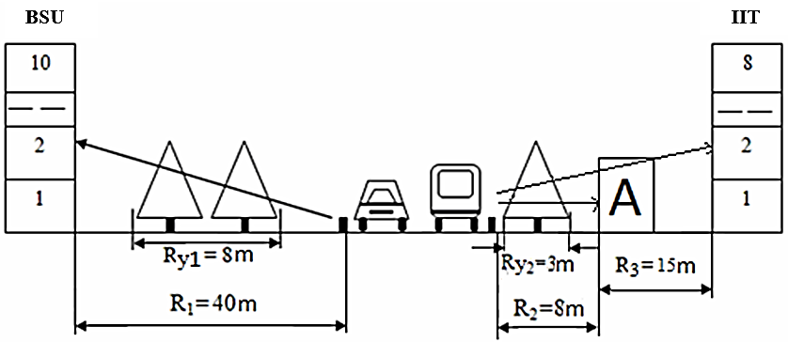


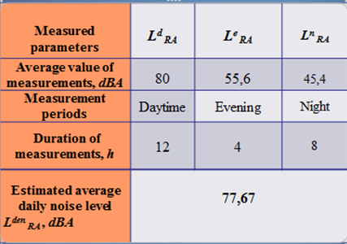
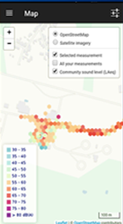

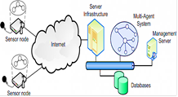

A methodology based on cyber physical systems platform for assessment of the safety of acoustic noise pollution
Agayev Bikes
Institute Information Technology ANAS, Baku, Azerbaijan
bikies418@gmail.com
Abstract
Acoustic noise pollution is currently a global environmental problem. Many citizens are interested in the following question: what is the level of noise pollution where I live, work or am? Does it meet standards? The average citizen cannot monitor noise by standard methods. This process is complicated, and the equipment is expensive. However, the computing, communication and sensory functions of modern mobile phones allow monitoring. To do this, they need simple and straightforward methodologies. The article proposes a simple monitoring methodology. A number of experiments are being carried out.
Introduction
Making calculations
As a result of the 4th industrial revolution, the ecological situation deteriorated. Environmental safety has become a global problem
One of the environmental problems is controlled by physical factors.
One of these factors is acoustic noise.
Acoustic noise - Unwanted harmful sound
Acoustic noise pollution (ANP) is harmful for human health this is a second environmental factor in action (I - air pollution).
WHO:16-20% of the world's population suffers from severe hearing loss.
Over the past 10-15 years, noise pollution in large cities has increased by 1.5 times
In the context of the 4th industrial revolution, protecting people from acoustic noise pollution caused by cyber-physical systems is an urgent problem.
Major sources of noise:
- Vehicles
- Technological and engineering equipment
- The noise of social and communal activities
Acoustic noise causes a number of diseases, or creates conditions for other diseases.
Therefore, people must be protected from the high acoustic noise pollution of the 4th industrial revolution
- A large number of measurements of the L_{d}^{RA} noise level are carried out for the daytime period (07:00-19:00), the L_{e}^{RA} noise level for the evening period (19:00-23:00), the L_{n}^{RA} noise level for the night period (23:00 -07:00) and the average values for each period are calculated;
- These values are used to calculate the average daily noise level. L_{den}^{RA}:
Ke, Kn – settings for evening and night periods: -5 dBA for evening hours, -10 dBA for night hours; e – the duration of the night period.
- to improve accuracy, average noise levels are calculated for a week, a month or a year:
Assessment of the noise level at the BSU and IIT
Mobile phone noise monitoring methodology
Monitoring is necessary to assess the harmful effects of acoustic noise pollution
Purpose:
- Measurement of the noise level of the area;
- Determination of the compliance of the noise level with the requirements of national standards;
- Carrying out certain protective measures if the noise level exceeds the norm.
Personal protective measures
If the noise level exceeds the norm, individual or collective protective measures are taken
• Reduction of the source noise level;
• Reduction of noise intensity along the propagation path;
• Architectural and planning techniques;
• Organizational and administrative measures
Use of personal protective equipment
The average citizen wants to know: what is the level of noise pollution where
I live, work, and am? Does it meet standards?
However, the computing, communication and sensory functions of modern mobile phones allow monitoring.
A simple methodology for monitoring on a mobile phone is proposed.
Principles of formation of Science 4.0
Conclusion
Acoustic noise pollution has been described as an environmental issue. The danger of noise pollution for human health is analyzed. The importance of assessing the level of noise pollution in the area where a person is has been substantiated. For this, a simple monitoring technique was proposed using the capabilities of mobile phones.
Monitoring methodology steps
Download and activate one of the applications with the Sound Meter function (Noise Detector, Spectroid, Sound Analyzer, Audio Spectrum Analyzer & Sound Frequency, etc.) for an Android smartphone (for example, the Redmi Note 8 brand by Xiomi) from the Google Play Store

