Slide 1
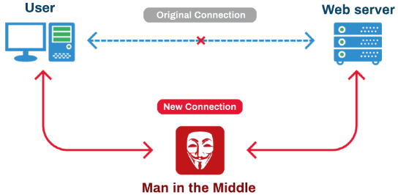
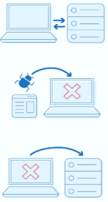
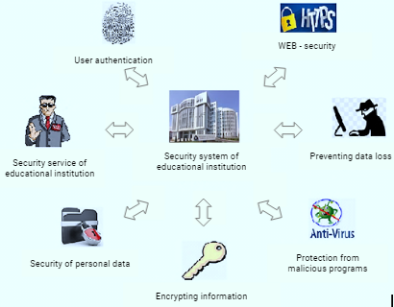
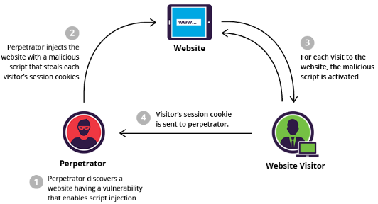
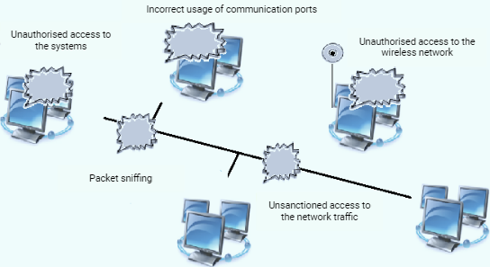
Risk Analysis and Assessment of the Security Level of the Electronic Educational System
Firudin T. Aghayev¹, Gyulara A. Mammadova², Rena T. Melikova³
Institute of Information Technology of ANAS, Baku, Azerbaijan
depart10@iit.science.az
Abstract
- cracking passwords using decryption systems;
- guessing the session ID of the website (session forecast).
The following guidelines should be followed [7-9]:
• the session identifier must be long enough and unpredictable;
• the session ID correctness must be checked;
• he "remember me" option (permanent logins) should be avoided;
• the session should be stopped when a security error is detected;
• the session should be stopped when inactivity period is exceeded;
• the session cookie should be deleted when the session is destroyed.
In recent years, e-learning has been widely used in many countries around the world. However, the availability of information resources of the network creates certain security problems of the educational process and personal data of students, theft or changes in the content of textbooks. This article discusses the different types of attacks on e-learning platforms and proposes solutions to protect educational information using security techniques and internationally recognized standards.
Introduction
A higher education institution uses a variety of information that requires protection. This is the personal data of students, teachers, administration and other categories of users. Compliance with security requirements in an e-learning system is an extremely difficult issue, since it is necessary to protect content, services and personal data not only for external users, but also for internal users, including system administrators [1]. In this article, we covered some of the key security issues to consider when designing and using eLearning.
Conclusion
In this article, we have described some aspects of the security of e-learning platforms and, in particular, analyzed the most important issues like cross-site scripting, SQL attacks, password cracking, etc. The development of e-learning systems should be carried out using security techniques and internationally recognized standards. The system must implement security services such as authentication, encryption, access control, user management and their permissions [10]. Data transfer between the system and content administrators or operators should be done over SSL encrypted channels through a web administration interface.
The main types of threats in e-learning
Generalized System for Ensuring the Security of E-education
The main elements of the implementation of threats to educational data in the university computer network can be objects or subjects that create these threats, the communication environment for the dissemination of personal data, media (a material object in which personal data is reflected in the form of text, video and sound information).These types of threats in the university network include DDoS attacks (Distributed Deny of Service Attack), MITM attacks (Man In The Middle), DNS attacks, CSU attacks, etc [2-3].
These attacks can be used to achieve the following goals:
access to confidential information;
identity theft;
changing the functionality of the browser;
damage to web applications;
denial of service.
The figure shows the most vulnerable areas of the spread of threats to educational data in the computer network of the university
References
Cross-Site Scripting (XSS)
[1] V. V. Gafner, Informazionnaya bezopasnost. - M.: Fenix, 2017, 336 p.
[2] P.P. Urbanovich. Informazionnaya bezopasnost I nadejnost sistem – Minsk: BGTU, 2007, 90 p.
[3] G. Gagne, P. B. Galvin, A. Silberschatz? Operating System Concepts, Publisher: John Wiley & Sons, 2012, p. 312.
[4] S. Fogie, J. Grossman, R. Hansen, A. Rager, P.Petkov. XSS attacks: Cross Site Scripting exploits and defense – Seth Fogie, Oxford: Elsevier, 2007. 448 p.
[5] M. Denis, C. Zena, T. Hayajneh, “Penetration Testing: Concepts, Attack Methods, and Defense Strategies”, ISBN: 978-1-4673-8490-2, DOI: 10.1109/LISAT. 2016.
[6] K. Ahmad, J. Shekhar, K.P. Yadav. Classification of SQL Injection Attacks. VSRD Technical & Non-Technical Journal Vol. I (4), 2010, рр. 236-242.
[7] Maraj, G.Jakupi, E.Rogova, Xh.Grajqevci, “Testing of network security systems through DoS attacks” , “Mediterranean Conference on Embedded Computing (MECO 2017), IEEE/Scopus conference, Montenegro, June 2017.
[8] Z. S. Alwan , M. F. Younis. Detection and Prevention of SQL Injection Attack: A Survey. International Journal of Computer
Science and Mobile Computing, Vol.6 Issue.8, August- 2017, pp. 5-17.
[9] J. Clarke. SQL Injection Attacks and Defense. Elsevier, 2012, p.761.
[10] D.M. Romanenko. Osnovi setevogo admonistrirovaniya, Minsk: BGTU, 2015, 135 p.
Common Vulnerable Spots in the Computer Network of
Electronic Universities
Methods for protecting educational information in electronic education
When an e-learning system is implemented in an educational institution, it should be validated for external intrusion issues such as [4,5]:
cross-site scripting (XSS - Cross-Site Scripting);
- remote injection using a virus / trojan file;
- SQL injection into the site address (URL SQL injection)[6];

