Slide 1
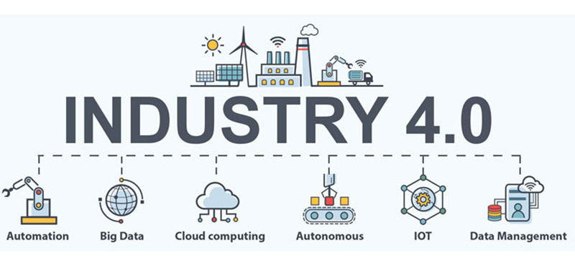
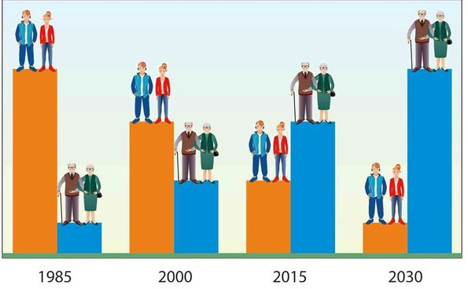
Analysis and research of the impact of Industry 4.0. challenges on demographic processes
Gulnara Nabibayova
Institute Information Technology ANAS, Baku, Azerbaijan
gulnarara58@mail.ru
Abstract
Some changes occurring in the demographic processes are associated with the changes in the labor market. These include the followings:
• release of personnel;
• development of new forms of employment;
• intellectualization of labor;
• an increase in educated unemployment;
• development of self-employment;
• development of multiple employment, etc. [5].
In the era of Industry 4.0, first of all, IT workers, programmers, engineers, etc. are required. Besides, in computer science, mathematics and engineering, men dominate. This demand for technical skills can cause gender inequality.
All these demographic changes are inevitable in the era of the formation and development of Industry 4.0 technologies.
However, there is another aspect of the influence of Industry 4.0 on demographic processes. There are many data sources in e-demographic DSS, which means an increase in the number of connections, and, consequently, the use of standard connection protocols that Industry 4.0 assumes. Thus, the need to protect the key systems of organizations from cyber threats becomes obvious. Therefore, secure connections and reliable approaches to managing access to systems are indispensable in the design and use of information systems. Damage, alteration or destruction of data by cybercriminals in the DW of e-demographic DSS can completely change the demographic picture provided by OLAP cubes. Obviously, this will lead to negative consequences for the analysis of this data by decision-makers in the field of demography. As a result, in the field of demography, the wrong decisions will be made, and this will affect the demographic processes in the region.
In order to solve the problem posed in the article, the characteristics of the Industry 4.0 (Fourth Industrial Revolution) are considered. In addition, the possibility of threats to the data security of an electronic demographic (e-demographic ) decision support system (DSS) from intruders in the context of Industry 4.0 is considered, due to the attack risks for them is very high. It is found out that the damage to these data will impact on the decision-making in the field of demography, and, consequently, on the course of demographic processes in the region. Solution ways of arisen problems are indicated.
Introduction
Demographic policy includes the solution of important social, economic, political and other problems [1]. Demographic research is of great importance for solving these problems, and the results of this research will form the basis for demographic policy.
Industry 4.0 technologies have a significant impact on the demographic processes. This paper describes the inevitable regular changes in the course of demographic processes in the conditions of Industry 4.0 as a result of the emergence of new technologies and their consequences. In addition, the issue of possible unauthorized interventions in demographic data, which can adversely affect decision-making in the field of demography, and on the course of demographic processes, is considered.
Cybersecurity of e-demographic DSS and Industry 4.0.
Recent research shows that the number of different systems facing cyber threats is growing steadily. Note that the growth in the number of detected incidents in the second half of 2020 is strongly influenced by COVID-19 compared to 2019, the number of hacked records increased by 50%. In total, 20,120,074,547 records were hacked in 2020 [6]. Providing the cybersecurity of the e-demographic DSS is a major challenge. First of all, it is necessary to be able to identify cyber incidents. The main forms of cyberattacks on systems include malware, cyber ransomware, mediation attacks, vulnerability attacks, DDoS attacks [7]. However, in the era of Industry 4.0, there are also potential types of cyberattacks that are difficult to predict at this time. They are the consequences of the use of the latest technologies, such as artificial intelligence, neuro- and nanotechnology, etc. In the context of Industry 4.0, cloud services are widely used as well. To gain access to the cloud, attackers mainly use malware, cross-cloud attacks, denial of service, attacks on computing resources, social engineering methods, etc. In order to secure the data of e-demographic DSS when using these technologies, it is necessary to take the following actions: encrypt data; use strong passwords and multi-factor authentication; carefully read the SSL (Secure Sockets Layer) certificate, etc. [8].
Electronic demography as a new field of demography
Conclusion
Today, in the era of the widespread use of information technologies, their influence on all spheres of human life and activities, a new field of demography, i.e., electronic demography (e-demography), has emerged. The article [2] presents the Conceptual model of the e-demography system. OLAP technology (Online Analytical Processing, OLAP) is indicated as one of the key units of this model, which can cope with existing problems in this area, providing analysts with a general picture of the process flow, making it possible to improve the analytical component of the process.
OLAP technology is an element of the data warehouse (DW) and uses its data. DW is a specially designed database with a large amount of data used for analysis and management decision-making. E-demographic DSS with DW and OLAP technologies included in it solves the following tasks: operational data processing, issuing ready-made reports on demand, visualization of reports in the form of tables and diagrams, etc. An important characteristic of demography is that it is an interdisciplinary field of research and defined as a multifaceted science. Therefore, a set of interconnected data marts is chosen as the architecture of DW [3]. DSS consists of three levels. The first level includes data sources.
Conclusion
It was found out that Industry 4.0 has a strong influence on demographic processes. This influence has two aspects: 1.when, under the influence of Industry 4.0, changes in demographic processes are inevitable. 2. in connection with cyber attacks on the demographic data of the e-demographic DSS, the number of which is increasing in the era of Industry 4.0.
Damage, modification or destruction of data in the DWs of e-demographic DSS will lead to the issuance of corrupted reports provided by OLAP cubes. Obviously, this will lead to negative consequences for the analysis of this data by decision-makers in the field of demography. Making decisions based on incorrect data may seriously affect the demographic processes in the region.
Thus, it is necessary to protect the e-demographic DSS from various types of cyber threats.
DM₁
DM₂
…..
DM_{n}
Extraction processes
Transformation processes
Loading processes
ETL Subsystem
Data source
State registries
Data source
…..
Data source
References
The second level includes the ETL subsystem (Extract, Transform, Load) [4]. The third level includes the DMs. DMs are focused on analyzing individual sectors of demography.
[1] Rudnitskaya A., Novikov E. The main directions of formation, problems and tasks of demographic policy in modern Russia. PolitBook. 2015. 1. P. 43–56. (in Russian).
[2] Alguliyev, R.M., Aliguliyev, R.M., Yusifov, F.F. & Alekperova, I.Y. (2019). Formirovanie elektronnoi demografi i kak eff ektivnogo instrumenta sotsialnykh issledovanii i monitoringa dannykh o naselenii [Developing Electronic Demography as an Effective Tool for Social Research and Monitoring Population Data]. Public Administration Issue, no 4, pp. 61–86 (in Russian).
[3] Nabibayova G. Decision Support System in Electronic Demography. CEUR Workshop Proceedings. UkrPROG2020, 12th International Conference of Programming. Kyiv, Ukraine, September 15-16, 2020. P.228-235. Available from: http://ceur-ws.org/Vol-2866/ceur_228-236_nabibayova.pdf
[4] Implementation of ETL (Extract, Transform, Load) subsystem of corporate data warehouse. URL: https://hadoop.apache.org/ (date of access: 09/27/2020).
[5] Tarasov I.V. Industry 4.0 Technologies: Impact on Increasing the Productivity of Industrial Companies. Strategic decisions and risk management. 2018; (2): 62-69. Available from: https://doi.org/10.17747/2078-8886-2018-2-62-69 (in Russian).
[6] Cybersecurity statistics for 2020. https://10guards.com/ru/articles/2020-cybersecurity-statistics/
[7] https://mediapark.com/ru/case-study-ru/cyber-security/ (date of access: 08/22/2021).
[8] https://smoff.ru/howitworks/zashchita-informacii-v-oblachnyh-servisah (date of access: 08/25/2021)
Aspects of the impact of Industry 4.0 on demographic processes
One of the characteristics of Industry 4.0 is the presence of cyber-physical systems based on new technologies and trends. With the introduction of Industry 4.0 technologies important economic transformations are taking place. Cyber-physical systems contribute to the development of safety, productivity, comfort and human health. In connection with the implementation of projects for the development and implementation of Industry 4.0 technologies, significant demographic changes are inevitable in various sectors of demography. Key demographic changes include:
• population aging;
• increase in life expectancy;
• urbanization of the population;
• an increase in the level of education
of the population, etc.
Gulnara Nabibayova
gulnarara58@mail.ru

