Slide 1
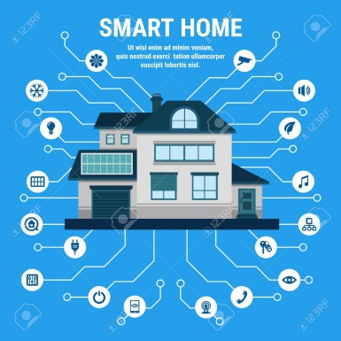
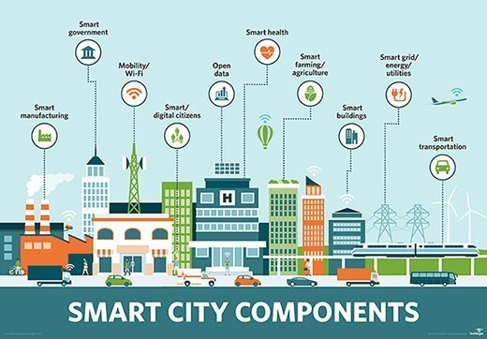
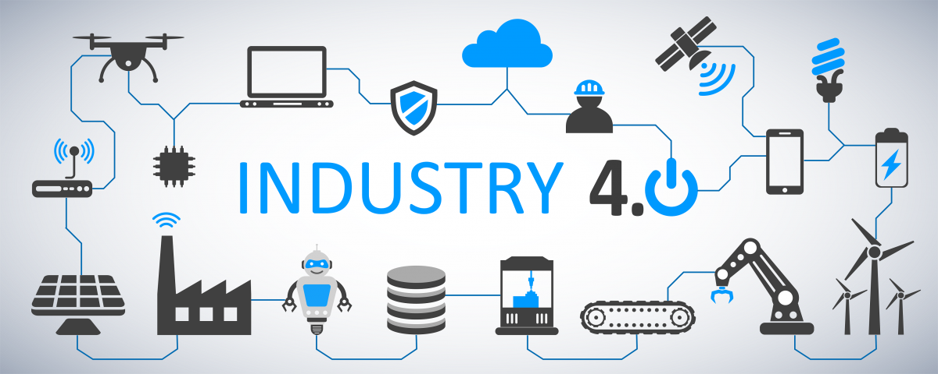
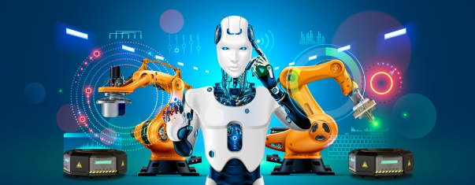
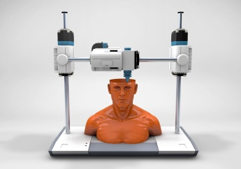
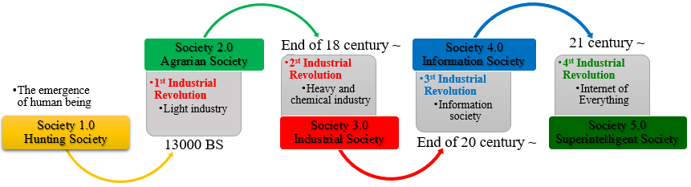
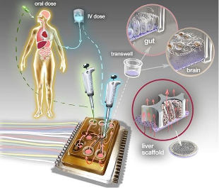


Cyber socio-technological problems of the networked society and their analysis
Konul Dashdamirova
Institute of Information Technology of ANAS, Baku, Azerbaijan
konulahmed@gmail.com
Abstract
"Smart Homes" increase the efficiency of resource usage, facilitate the detection of intrusion and the implementation of security measures. This realizes the remote control of household and the ability of people of different ages (young, old, disabled) to live independently. Also, we obtain advantages as reducing the cost of the health care system, real-time monitoring, and video, etc. However, the development of "Smart Homes" poses threats such as breaches of privacy, cyber-attacks, and surveillance of households by outsiders.
The article analyzes the evolutionary history of industrial revolutions, and points out the beginning of developing a "Society 5.0" or "Super Intelligent Society" in some countries. Moreover, the current state of digital technologies affecting the technological and social development of society is analyzed, the socio-technological problems of the Internet in a networked society are studied. The innovations of Industry 4.0 in the life of a networked society will exacerbate many problems.
Introduction
The development of a "Smart City" increases the efficiency of resource usage and improves people's life quality. This also assists reduce crime and pollution (air, noise), control climate change and the environment, and develop a "Smarter" e-government. Also, the problem of monitoring people and collecting personal data is becoming more actual, and if occurs an accident in the power supply systems, the risk of system collapse and vulnerability to cyberattacks increases.
Beginning in the 2nd half of the twentieth century, the transition to the Fourth Industrial Revolution, characterized by an integration of technologies abolishing borders between the physical, digital, and biological fields, began. The Fourth Industrial Revolution, or "Industry 4.0," is a transition to the entirely automated digital production where cyber-physical systems are mass-produced, that goes beyond the boundaries of a single enterprise, which is in constant interaction with the external environment, that have the perspective of joining goods and services to the global industrial network and can be controlled by real-time intelligent systems [2]. Also, innovations such as virtual reality, printing electronics, 3D printers, the Internet of Things, robots, and cloud technologies are becoming more widespread.
The usage of "big data" allows to speed up decision-making in many fields. Automated decision-making systems facilitate the citizens' lives and give opportunities to enterprises and governments to provide real-time services, make payments, automate tax returns, and solve various problems. However, problems connected to the loss of jobs, concerns about the security of personal information, and so on become more actual. Also, the questions arise "Who owns the big data analysis and management algorithms?" and "How can we trust big data?".
By 2025, self-driving cars on US roads are forecasted to contain 10% of total cars. Self-driving cars have been tested by big companies such as Audi and Google, and other companies developing new technical solutions are growing rapidly. Gradually, these vehicles may become more efficient and safer than the cars driving by a person. They can reduce traffic jams and wastes and also improve the use of existing models for transportation. However, the loss of jobs (taxi and truck drivers), the decrease in the number of car owners, and the increase in cyber-attacks are forecasted.
Analysis of the evolutionary history of society
The analysis of the evolutionary history of society shows that "Society 1.0" and "Society 2.0" are associated with the making of stone tools, the development of agriculture, the construction of the first settlements, mainly in rural areas, ie the creation of an agrarian society. "Society 3.0" is a society formed as a result of the industrial revolution that occurred in the leading countries of the world in the XVIII-XIX centuries, evolving from manual labor to machine labor, from manufacturing to the factory. Society 4.0 is an information society characterized by the development of general computerization and intellectual technologies. In such a society, resource consumption is optimized and labor productivity increases significantly. The main driving force in the implementation of these processes is the strategy "Industry 4.0", which is characterized by the use of the "Internet of Things" in the industry and the application of cyber-physical systems in production processes [5]. In some countries, the development and implementation of the concepts for "Society 5.0" or "Superintelligent Society", which considers the penetration of digital technologies in all spheres of life, has already begun.
Robotics began to affect many professions. It covers many fields, from production to agriculture, from retail to services. According to the International Federation of Robotics, currently there exist 1.1 million active robots in the world. In the automotive industry, 80% of work is done by robots. Robots modernize the functioning of the supply system, which allows achieving more efficient and predictable results in the economy.
The current period can be called the 3D century. 3D printing and 3D production technologies are spreading rapidly and are used in various fields, including education, medicine, jewelry, construction, textiles, toys and souvenirs, geoinformation, etc. 3D printing has the potential to create quite complex products without complicated tools.
Soon, 3D printers will use a variety of materials, including plastic, aluminum, stainless steel, ceramics, and even complex alloys. The printer will perform the whole work earlier carried out by the factory. However, the problems of increasing the number of wastes and piracy, the decay in the quality of brands and products, the loss of jobs will become actual [5].
Industry 4.0 technologies and cyber socio-technological problems of a networked society
Conclusion
The people number who are already connected to the devices is growing, and in some cases, these devices are connected to their organs. The devices are not only portable but are also implanted in the human body by the means of communication, to perform their functions such as determination of a person's location, monitoring of behavior and health, etc. "Smart" Tattoos and other unique chips allow determining the identity and their location. However, the privacy of people connected to the devices can be compromised by various authorities and we can get potential control over them. Also, a low level of information security can increase the risk of damage to people's mental and psychological health.
Investigations show that the digital technologies of Industry 4.0 have a significant impact on the technological and social development of society, but it also increases various problems. Applying comprehensive measures is necessary for the easy adaptation of the networked society to the challenges of "Industry 4.0", ensuring security, prevention of urbanization, etc. The Fourth Industrial Revolution will also influence the division of roles between countries. Therefore, the modernization of the fields such as economics, medicine, education, agriculture, etc. is important for the sustainable development of states. Considering that the new technologies will work without human intervention, the regulation of employment and unemployment should be one of the priorities of states. In the field of ICT should also be paid attention to the training of staff. In schools and even in kindergartens should be implemented programs to prepare children through special classes such as technological entrepreneurship and creativity.
Today, 59.5% of the world's population are Internet users. The existence of people in the digital world gives them opportunities such as freedom of speech, get information and disseminate it rapidly, exchanging information, using public services more efficiently, and so on. However, problems such as integrity violation of private life, potential control over people, personal information theft, online threatening, and the dissemination of inaccurate information are on the rise.
References
10% of people wear clothes connected to the Internet. Via the clothes connected to the Internet, people can check their treatment process, control children or pets, and take advantage of decision-making. Also, problems such as breach of privacy, increased dependence on devices, real-time identification, data security are becoming more urgent.
[1] Макарук Д. Г., Макарук О. Е. Цифровизация как шаг к Индустрии 4.0. 2019, c.151-157.
[2] Skobelev P. O., Borovik S. Y. On the way from Industry 4.0 to Industry 5.0: From digital manufacturing to digital society // Industry 4.0, 2017, №. 6. с. 307-311.
[3] Плакиткин Ю. А., Плакиткина Л. С., Дьяченко К. И. От цифровизации к" Индустрии-4.0" и" Обществу 5.0"-возможности адаптации угольной промышленности России, прогнозы развития отрасли до 2040 г // Горная промышленность. 2018. №. 5 (141), с.56-61.
[4] Белоусов В. Е. и др. Определение и свойства социокиберфизических систем // Проектное управление в строительстве. 2020, №. 4, с. 90-94.
[5] Клаус Ш., Дэвис Н. Технологии Четвертой промышленной революции. Litres, 2021.
By 2025, one trillion sensors are expected to be connected to the Internet. This will expand the opportunities of communication and services in connection with the emergence of new information, increase the efficiency and productivity of the various resources usage, improve the life quality of people, have a positive impact on the environment. However, problems as breaches of privacy, loss of jobs, cyber-attacks, security threats, etc. will become actual.
Konul Dashdamirova
konulahmed@gmail.com

