Slide 1
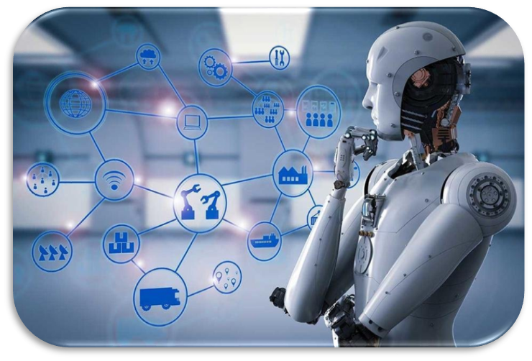
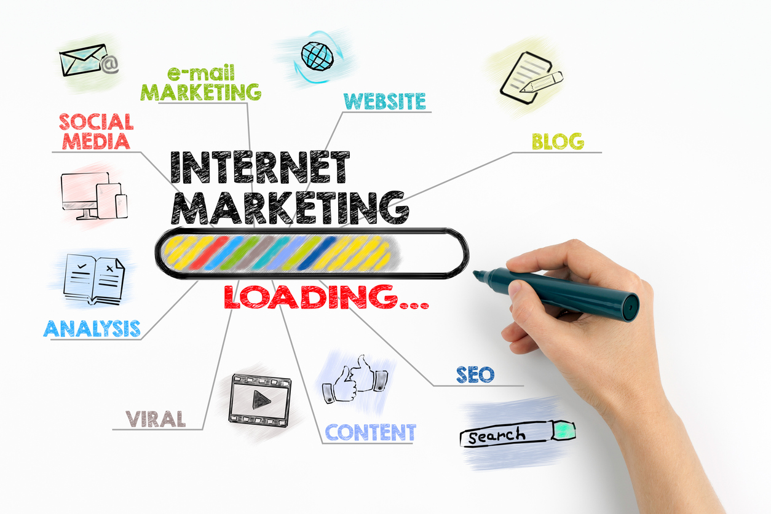
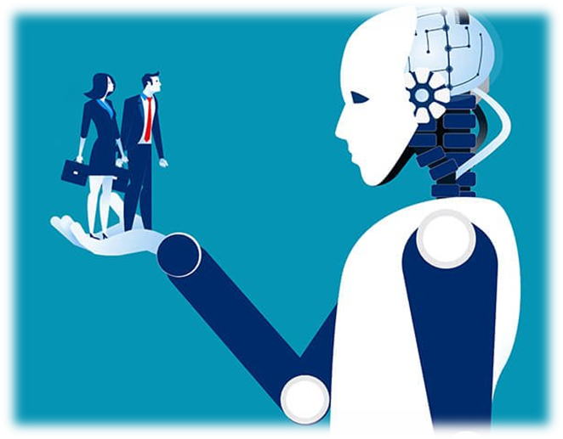
Issues and prospects of application of artificial intelligence in Internet advertising
Kamala Hashimova
Institute Information Technology ANAS, Baku, Azerbaijan
hashimovakama@gmail.com
Abstract
Smart billboards are a technical tool to fully express the opinion of an advertiser. The more attractive the billboards, the more CPM (cost per milliliter) they can get.
• Provide a Wi-Fi connection.
• Submission of requests and service requests
• Ports for charging mobile devices.
• Real-time product roadmap information
• Regular information about the brand on the business page on social networks.
Artificial intelligence plays a special role in new technologies used to develop advertising and marketing. Artificial intelligence, which plays a special role in improving the effectiveness of advertising and marketing, has had its say in the business market, and this process continues. A quick search for any product in Internet search engines is an indispensable process for the marketing market. With the help of artificial intelligence, it is possible to present the required product or service in a timely manner, at a high level, taking into account the individual characteristics of the customer using virtual environments and street advertising. In the modern world of cyber-physical systems, machines created using intelligent algorithms facilitate human labor in almost all areas. Intelligent management of a network of smart billboards AI research in advertising and marketing has a positive impact on economic development. The article discusses the use of artificial intelligence in the field of advertising, the principle of their work, the processes of applying new technologies in this area. In preparing the article, a scientific analysis of the problems on the topic, their solutions, generalization of the results and methods of a systematic approach were used.
Hyper Individualization and customization
An "individual" approach to the consumer to attract attention is an important decision to improve the service. Hyper-individualization is a slightly different form of individualization. Here you can understand how to treat the user, how much to contact him, place, date of purchase, information about a new brand. This personalization takes into account user behavior in real time. Personal information about a person obtained on the Internet practically adapts communication. Regardless of the size of the audience, artificial intelligence is able to create a unique dialogue with each user (advertising tool, email, website) and deliver relevant information.
With the advent of YouTube Director Mix (which is automatically based on video and many text changes), YouTube allows advertisers to create and submit customized ad campaigns. An integrated video template allows dynamic online videos to create news, search queries and design elements for different members of the target audience,
Introduction
Conclusion
The rapid expansion of Industry 4.0 has paved the way for the use of artificial intelligence technologies in advertising and marketing. Marketers with state-of-the-art technology can present the products that users want on time. As a result, both the seller and the buyer were satisfied with the service. With the help of artificial intelligence, product recommendations in advertising cause big changes, play an important role in the shopping process. We live in an era where artificial intelligence has infiltrated marketing. Currently, artificial intelligence is of great interest, because it is a priority in many areas. Along with online advertising, street advertising occupies a special place. Therefore, the use of artificial intelligence in marketing should be considered as one of the main areas of application. Many companies are spending a lot of money on
In marketing, SI has a positive effect on customer satisfaction and overall revenue growth. Over time, marketing has moved from traditional digital marketing to smart marketing. With new versions of networked AI algorithms, smart marketing applications are personalized and reflect the needs of customers. The AI ​​revolution in the industry is gradual, and advertising uses modern marketing and smart billboards. Artificial Intelligence will completely change our way of life in the coming years and will help us make the right decisions as we understand how information affects our lives. To improve the effectiveness of advertising and marketing, the prospects for the use of artificial intelligence technologies should be widely studied. More can be done by increasing attention to the possibilities of artificial intelligence, increasing the development of the economy by expanding the audience of buyers in the field of advertising and marketing. Therefore, in order to be among the leaders of Industry 4.0 and marketing, it is necessary to start mastering Industry 4.0 from this moment
figure
speech
semantic
analysis
Artificial
intellect
Machine
learning
Digital
logic
voice
recognition
References
research and development of artificial intelligence. Some sources predict that the use of artificial intelligence will reduce the workforce and lead to unemployment, while others predict that this will create great opportunities. If the marketing of advertised products and services is organized well, it will improve the well-being of people and lead to economic growth. The relevance of this article can be explained not only by the growing popularity of SI, but also by the growing volume of information and the importance of marketing.
[1]. A.Gebreselassie, R. Bougie, The Meaning and Effectiveness of Billboard Advertising in Least Developed Countries: The Case of Ethiopia J-l of Promotion Management 25(1):1-34,
[2]. M.Tironi, (De)politicising and Ecologising Bicycles, December 2014, Journal of Cultural Economy 8(2):1-18
[3]. Kim, E. (2016). “Yahoo has an idea for “smart” billboard that monitors people with a camera and microphone Business Insider Malaysia” | Retrieved July 19, 2017, from http://www.businessinsider.my/yahoo-patents-smart-
billboard-with-camera-and-microphone-2016-10/?r=US&IR=T
[4]. Digital Signage. (n.d.). Retrieved March 1, 2018, from
http://my.nec.com/en_MY/solutions/digital_signage/index.html
[5].https://ads.google.com/home/how-it-works/?subid=ww-ww-et-g-aw-a-vasquette_ads_cons_1!o2
[6].https://adindex.ru/publication/opinion/internet/2018/06/5/171591.phtml
[7]. https://itif.org/publications/2021/04/12/next-steps-ensuring-americas-advanced-
technology-preeminence, “America, we have a problem”
[8]. S.Okazaki, Measuring hard sell vs. soft sell advertising appeals,
July 2010, Journal of Advertising 39(2):5–20
[9]. Te-Kai Liu, Yun-Wu Huang, Jen-Yao Chung, Interactive Wireless Electronic Billboard, Conference: Networking, Sensing and Control, 2004 IEEE International Conference on, Volume: 1, April 2004, 553-558
[10]. J. Kietzmann, J.Paschen, E.R.Treen, Journal of Advertising Research, Artificial Intelligence in Advertising: How Marketers Can Leverage Artificial Intelligence Along the Consumer Journey, p:263-267, September 2018
[11]. H. Li, Special Section Introduction: Artificial Intelligence and Advertising, Journal of Advertising 48(4):1-5,09.2019
[12]. А.Kiseleva Advertising Intelligence. Can artificial intelligence revolutionize the advertising industry? 05 June 2018,
https://adindex.ru/publication/opinion/internet/2018/06/5/171591.phtml
What is artificial intelligence?
Artificial intelligence is the general name for algorithms and technologies, it is the goal of human intelligence. It is a hardware and software system with many capabilities such as human behavior, digital logic, movement, speech and voice recognition. It is also used for drawing automation, machine learning, semantic analysis, and large volumes of information tasks. In other words, artificial intelligence makes computers think like humans.
Kamala Hashimova
hashimovakama@gmail.com

