Slide 1
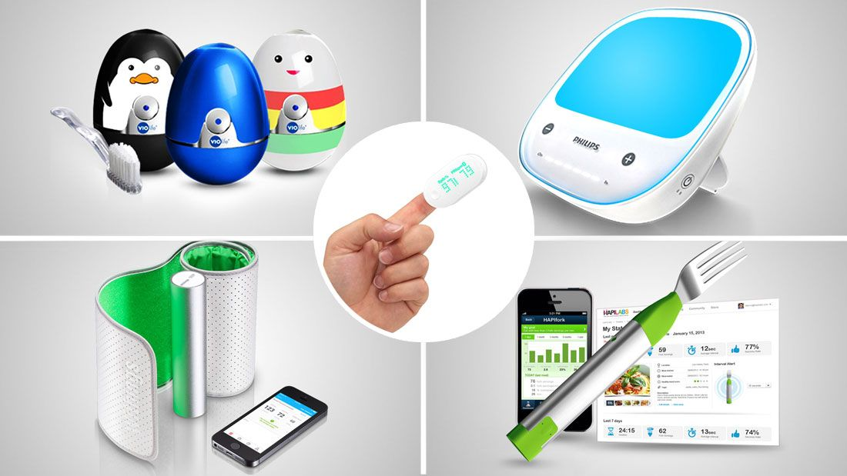
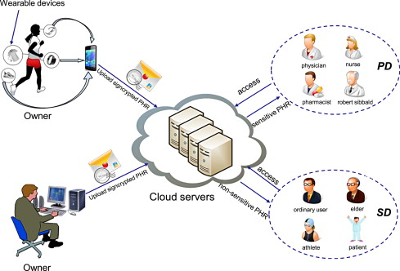
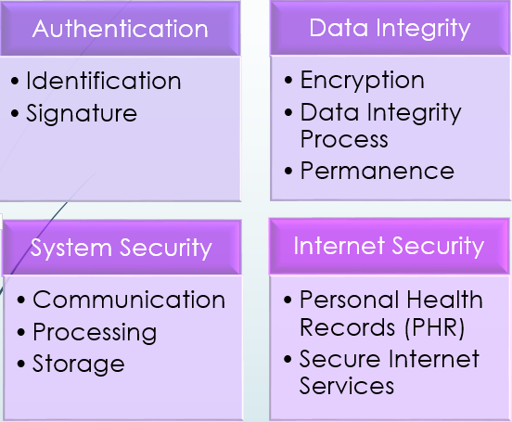
CYBER SECURITY ISSUES OF SMART DEVICES IN E-HEALTH : A REVIEW
Ogtay Alakbarov
Institute of Information Technology ANAS, Baku, Azerbaijan
oqtayalakbarov@yahoo.com
Abstract
Resulting in isolating and preventing sensor node within the range of the attacker signals for giving or receiving any message among the affected nodes and other sender nodes as long as the jamming signal continues.
Sybil Attacks: in Sybil, the attacker malicious node represents more than one identity in the network. It has important effect in geographic routing protocols. Where the location information is required to be exchanged between the nodes and their neighbors to route the geographically addressed packets efficiently
Attacks at storage level - These attacks may cause several threats to storage level such as modifying patient medical information or changing the configuration of system monitoring servers.[4,5]
Unauthorized access of Patient Medical Information
Malware attack
Removable Distribution Media Attack
Patient data protection is one of the main problems in e-medicine. The application of technology in medicine not only contributes to its development, but also raises the issue of personal data security. Several methods are used to solved this problem.[6,7]
Data encryption
Availability of several levels for data acquisition
Use of 2-stage security system
Attacks at transmission level -These attacks may cause several threats to transmission level such as spying, altering information, interrupting communication, sending extra signals to block the base station and networking traffic.
Eavesdropping of Patient’s Medical Information
Data Tampering Attack
Wormhole Attack
The term e-health is generally used to refer to the application of information technology in the delivery of different types of healthcare services. The use of technology in healthcare not only makes life easier for people, but also raises a number security issues. The article discuses and providers solutions for the security of smart devices and patient information stored in cloud services. Also considered were the methods of further enhancing the security of the electronic health system. Besides, the architecture and safety standards of smart hospitals have been researched.
INTRODUCTION
As we know, advances in information technology have the potential to improve many facets of modern healthcare services. The use of smart devices in healthcare makes life easier for people. Smart devices - Equipped with various sensors and transmitters, having a wireless network and designed to make life easier for humans. Smart devices are used in many areas of medicine. Despite the advantages of e-health, Security issues on e-health systems are on the increase. Such as data loss, hackers hijacking information, integrity and confidentiality bridge amidst other security challenges. This paper aim at identifying the security challenges of e-health systems, by discussing various ways in which e-health systems can be vulnerable to attack.
Introduction
Conclusion
SECURITY ISSUES IN E-HEALTH
Threat to a system comes in various forms. Various e-health security issues and the reviewed solutions are given. There are 4 main security issues in e-health. [1]
1. Unauthorized Access to Patients Information
2. Data Integrity
3. System Security Issues
4. Internet Security Issues
References
SECURITY ISSUES IN E-HEALTH
CONCLUSION
Numerous benefits such as reduced errors, authorized and secured access to patient's health data, reduced test duplication, environmental and financial cost reduction, enhanced public health care delivery service and a host of others abound in the deployment of eHealth system. If the solutions mentioned in this paper are implemented, it will give eHealth a hitch free environment to stride and is capable of minimizing if not eliminating the above named issues. Future research will be on the evaluation and sustainability of these proposed architectures in resolving eHealth security and privacy issues.
SECURITY ATTACKS IN HEALTHCARE SYSTEMS
REFERENCES
Healthcare systems are vulnerable to penetration by malicious attacks or intentionally from users for profit. This damages the effectiveness or deterioration the performance of healthcare systems. Specifically hospital networks, or the personal health data can be hacked or stolen by malicious users.[2,3]
Attacks at data collection level
Attacks at transmission level
Attacks at storage level
Attacks at data collection level - These attacks may cause several threats to data collection level such as altering information, dropping some important data, or resending data messages.
Jamming Attack: refers to interference attacker's radio signal with frequencies of the BAN (Body Area Networks).
[1] Patience E. Idoga, Mary Agoyi “Review of security issues in e-Healthcare and solutions”, HONET-ICT, 2016.
[2] Wang, J., et al., A Research on Security and Privacy Issues for Patient Related Data in Medical Organization System. International Journal of Security and Its Applications, 2013. 7(4): p. 287-298. [3] Zhang, K., et al., Security and privacy for mobile healthcare networks: from a quality of protection perspective. IEEE Wireless Communications, 2015. 22(4): p. 104-112
[4] Ramli, R., N. Zakaria, and P. Sumari, Privacy issues in pervasive healthcare monitoring system: A review. World Acad. Sci. Eng. Technol, 2010. 72: p. 741-747.
[5]Zhang, R. and L. Liu. Security models and requirements for healthcare application clouds. in 2010 IEEE 3rd International Conference on Cloud Computing. 2010. IEEE.
[6] Carmen C, Peris-Lopez P, Tapiador J. E. (2015) 'Security and Privacy Issues in Implantable Medical Devices: A Comprehensive Survey'. Journal of Biomedical Informatics 2015
[7] Frontoni, E., Baldi, M., Zingaretti, P., Landro, V., & Misericordia, P. (2014, October). Security issues for data sharing and service interoperability in eHealth systems: the Nu. Sa. Test bed. In Security Technology (iCCST), 2014 international Carnahan Conference on (pp. 1-6). IEEE.
Ogtay Alakbarov
oqtayalakbarov@yahoo.com

