Slide 1




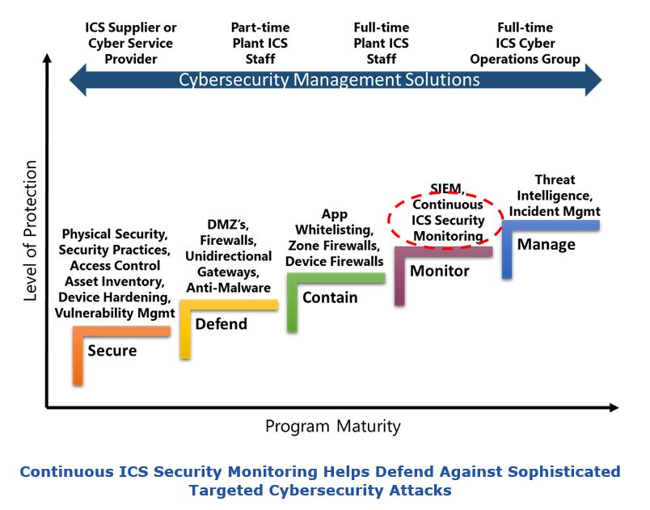
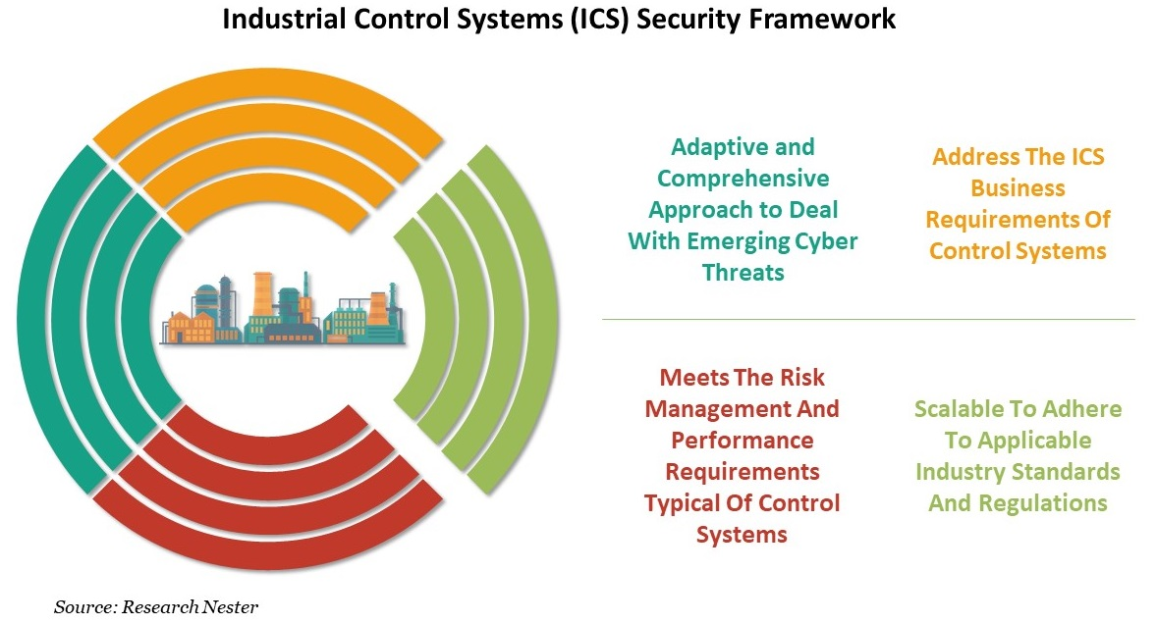
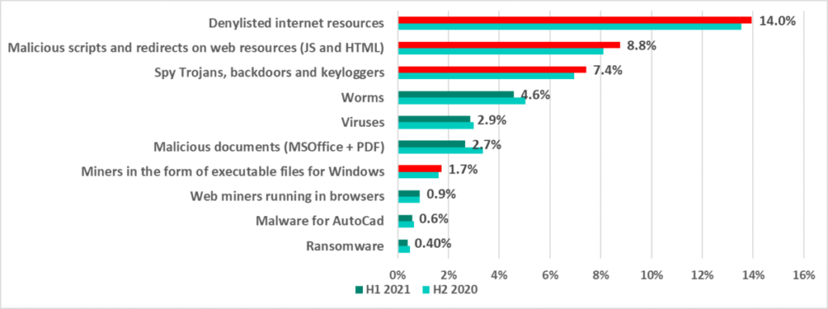
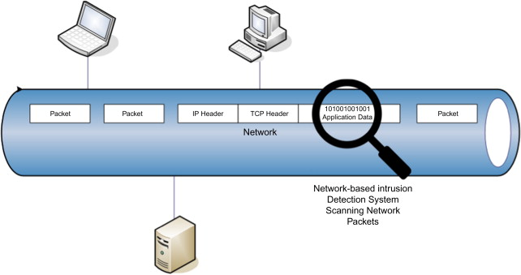



Some approaches to intellectual monitoring of industrial control systems cybersecurity
Ramiz Shikhaliyev
Institute Information Technology ANAS, Baku, Azerbaijan
ramiz@science.az
Abstract
Authors in [9] propose an OCSVM (One-Class SVM) intrusion detection mechanism, which is based on unsupervised machine learning methods, that does not need any labeled data for training or any information about the anomaly. In [10] authors propose data mining-based machine learning techniques for cybersecurity in SCADA systems. Authors in [11] propose a SCADA intrusion detection system based on self-learning semi-supervised OCSVM (S2 OCSVM) and demonstrate that S2 OCSVM can improve detection accuracy. In [12] proposed an architecture of an anomaly detection system based on the Hidden Markov Model (HMM) algorithm for intrusion detection in ICSs, especially in SCADA systems interconnected using TCP/IP. In [13] a simple one-class classification approach in the feature space is proposed. The authors in focus on the detection of cyber-attacks in water distribution systems using machine learning techniques.
For security of the modern industrial control systems (ICS) basic protective tools can be used. These tools can protect against common attacks and be sufficient for low-risk systems. The required security level of the ICS be ensured by constantly monitoring. With increase of the monitoring data volume, increase the costs of ICS resources consumption, as well as the data analysis becomes more complicated. It is necessary to intellectualize the security monitoring of the ICS. The purpose of this article is to study the approaches to intellectualization of monitoring the security of ICS.
Introduction
Over the past decade, there have been a small number of openly documented cyberattacks targeting industrial control systems (ICS). Consequently, not having enough attack patterns to define a risk threshold makes it difficult to understand the threat environment, prioritize security efforts, and justify resource allocation. This situation makes it very important to monitor the security of the ICS. Organizations can mitigate threats and reduce the risk to the production environment by implementing a comprehensive monitoring infrastructure for the ICS network. Having an effective intellectual monitoring infrastructure is essential because organizations can not only detect problems early, but also mitigate the consequences without any real damage and get rid of this phenomenon faster, regardless of its nature.
Conclusion
The sophistication of new malwares has made it very difficult to prevent and detect attacks on the ICS. In most cases, the success of such attacks to the fact that most of the existing ICS technologies were designed with reliability, relegating security to a secondary role. Therefore, there is a need for new approaches of security monitoring for ICS systems. Applicability of the machine learning techniques has proven to be very useful for this matter.
Threats to industrial control systems
References
The various sets of ICS threats spanning the ICS threat landscape can be decomposed into threats stemming from [1]:
1. Organizational aspects related to the organization and its subcontractors involved in the deployment, use, and maintenance of ICS;
2. ICS architecture and ICS technology;
3. Networking and telecommunications;
4. Human factors;
5. Operational maintenance;
6. The environment of ICS systems and communications.
[1] E. J. M. Colbert and A. Kott “Cyber-security of SCADA and Other Industrial Control Systems” Advances in Information Security (eBook), 2016, vol. 63, 355 p.
[2] C. Modi, D. Patel, B. Borisaniya, H. Patel, A. Patel, M. Rajarajan, "A Survey of Intrusion Detection Techniques in Cloud," Journal of Network and Computer Applications, vol. 36.1, pp. 42-57, 2013.
[3] M. Zhou, R. Zhang, W. Xie, W. Qian, A. Zhou, “Security and Privacy in Cloud Computing: A Survey,” in IEEE Sixth International Conference on Semantics Knowledge and Grid (SKG), pp. 105-112, 2010.
[4] Y. You, M. Zulkerine, A. Haque, “A Distributed Defense Framework for Flooding-Based DDOS Attack,” in Proceedings of the Third International Conference on Availability and Security, pp. 245-252, 2008.
[5] B. Zhu, S. Sastry, “SCADA Speciﬁc intrusion detection/prevention systems: A survey and taxonomy”. In Proceedings of the 1st Workshop on Secure Control Systems (SCS), Stockholm, Sweden, 12 April 2010.
[6] L.A. Maglaras, J. Jiang, T.J. Cruz, “Integrated OCSVM Mechanism for intrusion detection in SCADA systems”. Electron. Lett. 2014, 50, 1935–1936.
[7] T. Morris, Z. Thornton, I. Turnipseed, “Industrial Control System Simulation and Data Logging for Intrusion Detection System Research,” 7th Annual Southeastern Cyber Security Summit, Huntsville, AL. June 3-4, 2015.
[8] S. L. P. Yasakethu, J. Jiang, “Intrusion Detection via Machine Learning for SCADA System Protection,” in Proceedings of the 1st International Symposium on ICS & SCADA Cyber Security Research, pp. 101-105, September 2013.
[9] L. A. Maglaras, J. Jiang, “Intrusion Detection in SCADA Systems Using Machine Learning Techniques,” Science and Information Conference (SAI), London, pp. 626-631, 2014.
[10] S. Dua, X. Du, “Data Mining and Machine Learning in Cybersecurity,” Auerbach Publications, Boston, 2011.
[11] Y. G. Zhang, W. Zhang, X. R. Xue, X. J. Yang, “SCADA Intrusion Detection System Based on Self-Learning Semi-Supervised One-Class Support Vector Machine,” Metallurgical Industry Automation, vol. 37(2), pp. 1-5, 2013.
[12] K. Stefanidis, A. G. Voyiatzis, “An HMM-Based Anomaly Detection Approach for SCADA Systems,” in IFIP International Conference on Information Security Theory and Practice, pp. 85-99, Springer International Publishing, September 2016.
[13] P. Nader, P. Honeine, P. Beauseroy, “Detection of Cyber Attacks in a Water Distribution System Using Machine Learning Techniques,” in Sixth International Conference on Digital Information Processing and Communications (ICDIPC), pp. 25-30, April 2016.
Approaches to intellectual monitoring of ICS security
Recently, there has been a trend towards the implementation of machine learning techniques for anomaly detection and prevention in the networks of the ICSs/SCADA (Supervisory Control and Data Acquisition) [2-4]. Many monitoring proposals have focused on revising enterprise solutions, such as Intrusion Detection Systems (IDS) [5, 6]. But, these approaches are successful at identifying a limited range of attacks. SCADA systems, have regular communication patterns, which can be used exploited by machine learning algorithms [7]. In [8], for SCADA protection proposed an IDS based on machine learning methods. The authors compare rule-based methods, ANN (Artificial Neural Networks), HMM (Hidden Markov Model) and SVM (Support Vector Machines).
Ramiz Shikhaliyev
ramiz@science.az

