Slide 1
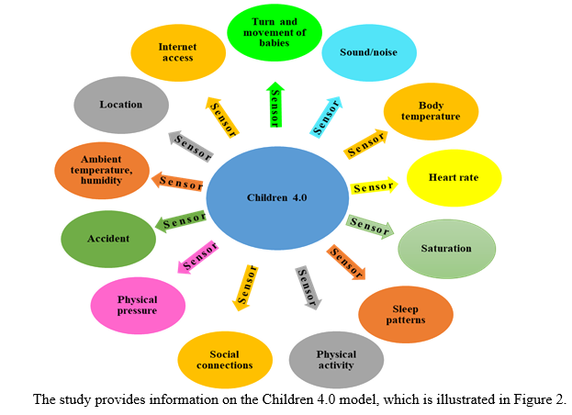
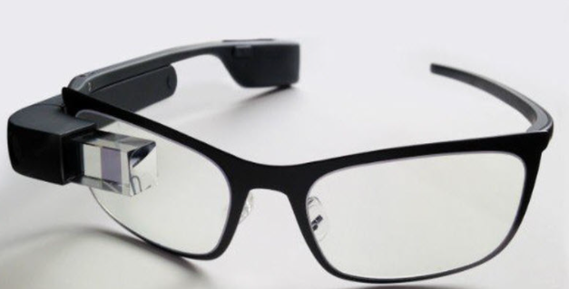
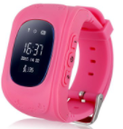
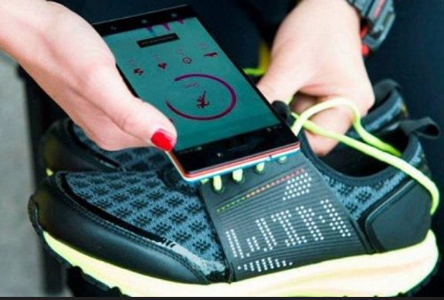
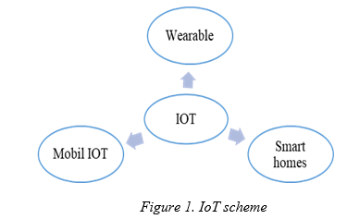


About A Comprehensive Approach To Ensuring The Children’s Safety In Terms Of Industry 4.0
Sabira Ojagverdiyeva
Institute Information Technology ANAS, Baku, Azerbaijan
sabiraas@list.ru
Abstract
Proposed Children 4.0 concept
Industry 4.0 influences children's activities, as well as all areas, opens up new opportunities and at the same time actualizes cybersecurity issues. This study provides information on the concept of the safety of children’s data environment. It highlights the concept of Children 4.0, which offers a comprehensive approach to ensuring the safety of data included in databases (medical data safety, spatial data safety, etc.) through wearable devices.
These intelligent systems must be able to processing big amounts of collected data quickly, make decisions based on the collected data, and have the following characteristics: analyze; monitor; Store data in the cloud; Risk assessment; and so.
Personal information that makes up Big Data can often be used by marketing companies, banking systems, various health care organizations, demographic analysis organizations, as well as some criminal groups. This can cause some problems with the security of the data collected. It can be concluded that it is more important to ensure the security of personal data entering the systems than to collect it. Because here certain problems can arise. Some of these problems can be named below:
Intradaction
Industry 4.0 emerged as a phenomenon at a time when technology was developing rapidly, new thoughts, ideas, etc. views were being formed. Industry 4.0 is characterized by the advanced digitalization. In the current situation, the surrounding movable, immovable, stationary, non-stationary, animals, people, trees, and other subjects are all networked through various sensors. This networking in society is created not only by means of computers, but also through various objects and accessories (gadgets, watches, bracelets, subcutaneous sensors, etc.) [1].
The processes affect growing children as the most sensitive member of society in the environment where information technologies develop. Various digital devices are being integrated into children's lives along with the information technologies over time. These devices provide convenience, speed or accuracy in obtaining and transmitting information, but also create certain problems for children’s safety.
Introduction
Medical information security of information on the child's health;
Information security of transmitted information in emergencies faced by children, as well as in special risk situations;
Security of children's spatial information;
Security of information on children's social relationships
Security of information about children's personal data.
Digital objects (sensory toys, control devices, the devices that recall various tasks and monitor children's activities, etc.) are of special importance in children's lives. Information about children's movements, sleep patterns, activities at school, gym or other places, and the people they interact with are always of interest to their parents [2,3].
It is known that the volume of data transmitted through digital objects increases over time, and the processing and storage of this data requires the use of Big Data technologies. So, large amounts of data are entered into the database online and carry out a fast-processing process. In this case, it is difficult to make decisions based on data collected in different systems, and a need arises for intelligent systems in the analysis of this data, which creates Big Data.
It is important to make assessments based on information obtained from sensors of various nature, to determine the level of threats and to take action in accordance with the target of these threats for ensuring security. According to the information entered into the system, it includes the child's location, people around him, the child's physical condition and various anomalous situations.
This intelligent system used for the safety of children learns more about each child under supervision and models it so much that as if it's creating its digital twins. Digital twins mean digital representations of physical or potential physical objects. The use of digital images are primarily important and irreplaceable for the virtual design and optimization of intelligent production systems in the Industry 4.0 environment for digital testing, digital modeling, forecasting training, decision making and various purposes. [9].
IoT
The main goal of the Internet of Things (IoT) is to create safe, reliable and fully automated smart environments [4]. The Internet of Things is a manifestation of digital technologies and able to gain information about children's relationships with things [2,3]. Now it represents the billions of physical devices in the world connected to the Internet, these devices collect and share all the data. IoT shows that computers connected to a network are at the same time connected to objects [4].
Conclusion
New forms of interaction with information technology are emerging as the Internet develops. The use of devices equipped with Artificial İntelligence (AI) and Big data technologies has become a tradition. Sensor-enabled devices that forms Big Data accelerate the exchange of information between individuals are very important for people's decision-making.
The proposed concept is important for ensuring the security of children's personal information, preventing any physical and psychological pressure on them. It also provides control over children's school, sports, etc. activities in life and such other situations. .
IoT systems are classified into two broad categories [5]:
IoT-specific
Consumer IoT (CıoT)
IoT-specific systems are designed to meet the requirements of applications in specific areas and require access to specific companies. Consumer IoT systems are easily accessed by the general public.
Wearable IoT. These items are computers with sensors and actuators / output devices, designed as a clothes, accessory, or device that consumers wear (or carry).
Smart homes. These devices are placed in homes in order to simplify the lives of consumers in terms of safety, convenience and entertainment. This category may also include toys connected to the Internet.
References
Approaches to intellectual monitoring of ICS security
[1] S. Weyer, M. Schmitt, M. Ohmer, D. Gorecky, Towards Industry 4.0 –Standardization as the crucial challenge for highly modular, multi-vendorproduction systems, IFAC-PapersOnLine 48 (3) (2015) 579-584,https://doi.org/10.1016/j.ifacol.2015.06.143;
[2] Hung P.C.K., Iqbal F., Huang SC., Melaisi M., Pang K. (2016) A Glance of Child’s Play Privacy in Smart Toys. In: Sun X., Liu A., Chao HC., Bertino E. (eds) Cloud Computing and Security. ICCCS 2016. Lecture Notes in Computer Science, vol 10040. Springer, Cham. https://doi.org/10.1007/978-3-319-48674-1_20
[3] Ghosh, U., Rawat, D.B., Datta, R., & Pathan, A.-S.K. (Eds.). (2020). Internet of Things and Secure Smart Environments: Successes and Pitfalls (1st ed.). CRC Press.
[4] The Fourth Industrial Revolution/As technology advanced at high speed, questions on preparedness and implications are raised, https://www.unicef.org/innovation/stories/ready-for-fourth-industrial-revolution
[5] Ghosh, U., Rawat, D.B., Datta, R., & Pathan, A.-S.K. (Eds.). (2020). Internet of Things and Secure Smart Environments: Successes and Pitfalls (1st ed.).
[6] What is the IoT? Everything you need to know about the Internet of Things right now, https://www.zdnet.com/article/what-is-the-internet-of-things-everything-you-need-to-know-about-the-iot-right-now/
[7] A J. Perez, S. Zeadally, and J. Cochran “A review and an empirical analysis of privacy policy and notices for consumer Internet of things,” Security and Privacy, e15,
[8] A. Godfrey, V. Hetherington, H. Shum, P. Bonato, N. H. Lovell, and S. Stuart, “From A to Z: Wearable technology explained,” Maturitas, vol. 113, no. April, pp. 40–47, 2018, doi: 10.1016/j.maturitas.2018.04.012.
[9] G. Shao, S. Jain, C. Laroque, L. H. Lee, P. Lendermann and O. Rose, "Digital Twin for Smart Manufacturing: The Simulation Aspect," 2019 Winter Simulation Conference (WSC), 2019, pp. 2085-2098, doi: 10.1109/WSC40007.2019.9004659.
Mobile IoT. This category includes bicycles, smart cars, drones, and vehicles used by people for transportation and / or recreation. Smartphones can also be included in this category.
Wearable things - sensor technology
Recently, the rapid development of sensor technology and ubiquitous computing has increased noticeably. Wearable, inexpensive, sensor-based and the devices, which include recognition systems for human activity, have become very popular. Today, there are smartphones, sensor bracelets, rings, watches, glasses, and even shoes equipped with ubiquitous computing and the number of these items continues to grow [6].
Sabira Ojagverdiyeva

