Slide 1
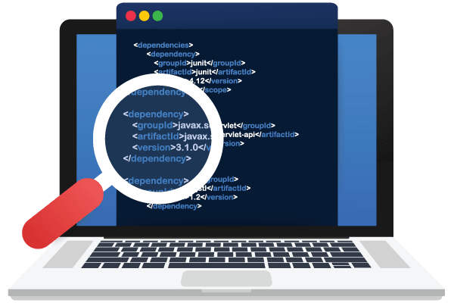
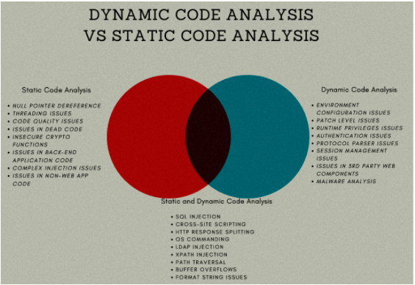
Analysis of modern methods for detecting vulnerabilities in software for industrial information systems
Tamilla Bayramova
Institute Information Technology ANAS, Baku, Azerbaijan
tamilla@iit.science.az
Abstract
Identification and situation analysis
Errors and vulnerabilities in software are analyzed and problems of their detection are considered. Existing modern methods of vulnerability detection using artificial intelligence technologies are studied. In addition to detecting these cybersecurity vulnerabilities in a timely manner, it specifies the correct choice of software development technologies, methods and operating conditions to prevent them.
Static code analyzers include the following tools:
HP Fortify Static Code Analyzer (SCA), ITS4 , RATS, Pscan, Nessus scanner, Metasploit framework, Checkmarx CxSAST, IBM Security AppScan Source, PT Application Inspector, InfoWatch Appercut, Digital Security ERPScan etc.
Web Application Scanners: Gamascan, Wapiti Wapiti etc.
Dynamic code analyzers include the following tools:
Valgrind, BOON, MOPS, Viva64, EXE, Flayer, IBM AppScan Standard, ThreadSanitizer etc.
Introduction
Currently, one of the negative factors affecting information security is the strengthening of information and technical impact on information infrastructures from foreign countries for various purposes. At the same time, there is a growing number of covert attacks aimed at disrupting or completely disrupting critical infrastructure of key government agencies. The safety of the country and society usually depends on the operation of these facilities.
Vulnerability patterns based solely on human experts are time consuming and error prone, which has motivated the use of machine learning to discover vulnerabilities. Recent research shows that it is possible to use deep learning to automatically detect vulnerabilities to relieve human experts from the need to define rules or patterns for vulnerabilities.
Figure 1. Threat landscape for industrial automation systems
The application of the above measures increases the cost of the software product, increases the financial and time costs of the organization. Therefore, when choosing tools and methods for protecting and searching for vulnerabilities, it is necessary to find ways to reduce costs using modern decision-making methods. One of these areas is the use of fuzzy logic in solving problems of assessing the level of information security of the software being created. This allows you to efficiently, quickly and conveniently process large amounts of data obtained using the expert assessment method.
Critical information infrastructures are usually understood as information systems, information and telecommunication networks, automated control systems for important government facilities. The development of intelligent industrial systems has created new safety challenges. The need arose to develop new methods and technologies to ensure the security of the critical information infrastructure of the "smart city". The number of vulnerabilities in software designed for automated process control is constantly increasing (Figure 1).
Databases of software vulnerabilities
Conclusion
CVE (Common Vulnerabilities and Exposures) is a database that records bugs and vulnerabilities found in software.
CWE (Common Weakness Enumeration) is a database of software vulnerabilities that can be exploited during malicious attacks.
NDV (National Vulnerability Database) - NVD is a US government repository, NVD includes databases of security reference lists related to security software flaws, misconfigurations, product names and impact metrics.
CVSS (Common Vulnerability Scoring System) is a database for assessing the security rating of software vulnerabilities. CVSS consists of three groups of indicators: baseline, temporary and environmental, each of which consists of a set of indicators.
CAPEC (Common Attack Pattern Enumeration and Classification) is a catalog of popular attacks.
MITER ATT & CK Matrix (Adversarial Tactics, Techniques & Common Knowledge) is a database that provides a formal description of the tactics and technologies with which cyberattacks are carried out;
Bank for Information Security of Russia - a database of vulnerabilities and threats.
Thus, we can say that it is impossible to protect the program code 100% from attacks, errors can occur at different stages of software development, many of which are difficult to detect. However, with particular attention to error detection during the design, coding and testing phases, vulnerabilities can be minimized if predicted and detected using both expert and automated tools, and software can be better protected against malicious attacks.
References
[1] R. Amankwah, P. Kwaku Kudjo, S. Y. Antwi. Evaluation of Software Vulnerability Detection Methods and Tools: A Review. International Journal of Computer Applications (0975 – 8887) Volume 169 – No.8, July 2017, pp. 22-27.
[2] https://cve.mitre.org/
[3] https://cwe.mitre.org/
[4] https://nvd.nist.gov/
[5] https://capec.mitre.org/
[6] https://bdu.fstec.ru/threat
[7] Y. Shin, A. Meneely, L. Williams and J. A. Osborne, "Evaluating Complexity, Code Churn, and Developer Activity Metrics as Indicators of Software Vulnerabilities," in IEEE Transactions on Software Engineering, vol. 37, no. 6, pp. 772-787, Nov.-Dec. 2011, doi: 10.1109/TSE.2010.81.
[8] G. Lin, S. Wen, Q. -L. Han, J. Zhang and Y. Xiang, "Software Vulnerability Detection Using Deep Neural Networks: A Survey," in Proceedings of the IEEE, vol. 108, no. 10, 2020, pp. 1825-1848.
[9] Shizhuang YIN, Quan SHI, Yadong WANG and Cai CHEN. Summary of software reliability Research. IOP Conference Series: Materials Science and Engineering 2020, pp. 1-6.
[10] Zhuobing Han∗, Xiaohong Li∗, Zhenchang Xing†, Hongtao Liu∗, and Zhiyong Feng‡2017 IEEE International Conference on Software Maintenance and Evolution, pp.125-136.
Vulnerability assessment tools
For cybersecurity, there are various modern technologies in the form of scanners, intrusion prevention systems (IPS), intrusion detection systems (IDS), network application firewall.
The mechanism of static analysis (Static Application Security Testing, SAST - static testing of application security), produced on the source code of the analyzed program and implemented without its actual execution.
Dynamic Application Security Testing (DAST), which requires an application security analysis to be performed without access to the source code and runtime of the application backend. Dynamic analysis is based on the launch of the investigated product for execution.

