Slide 1
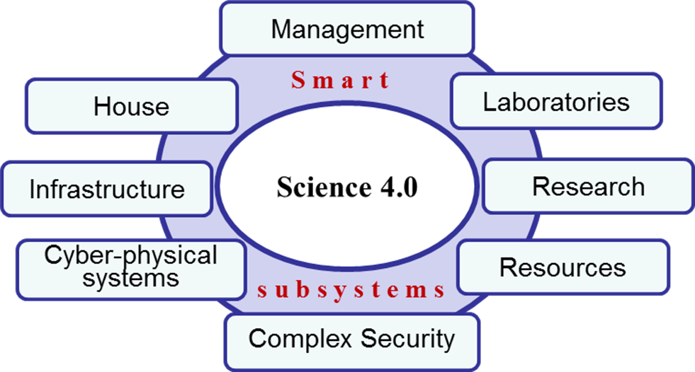
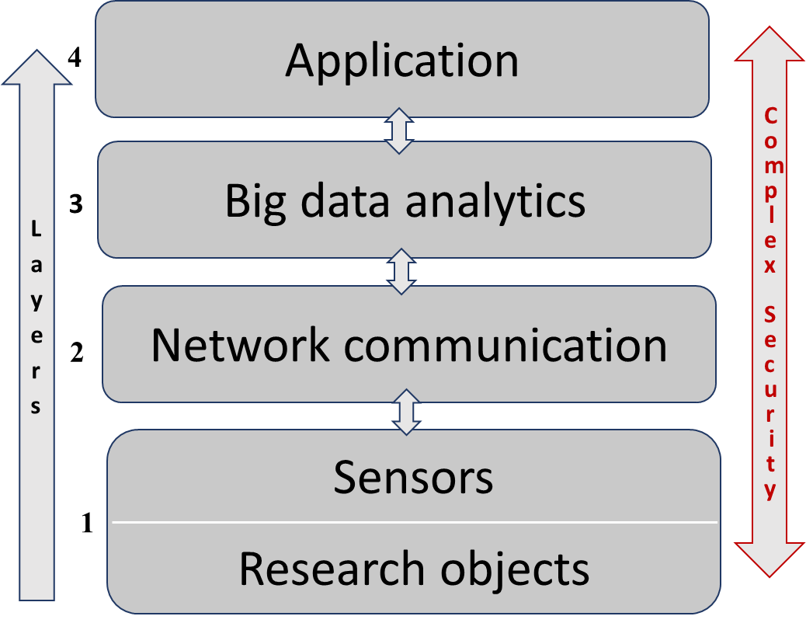
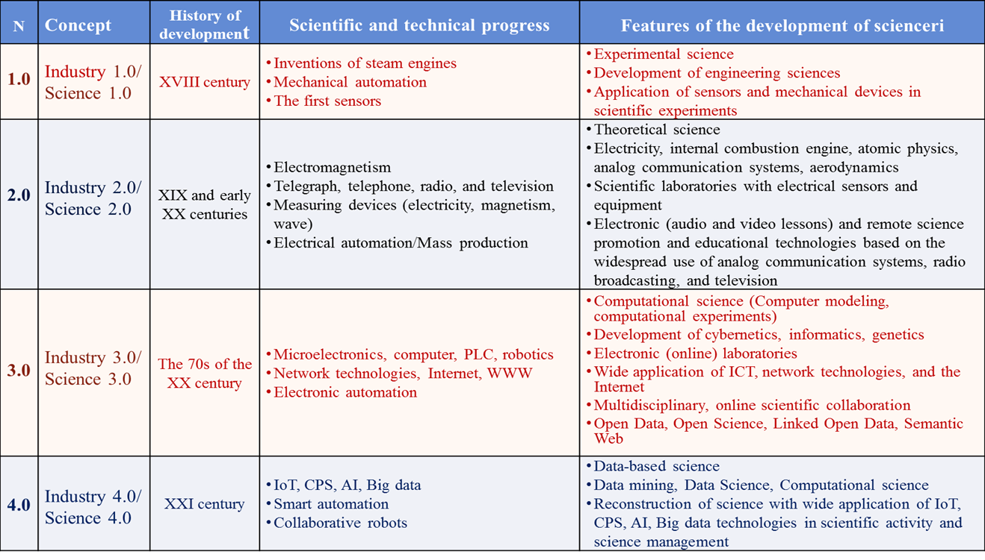
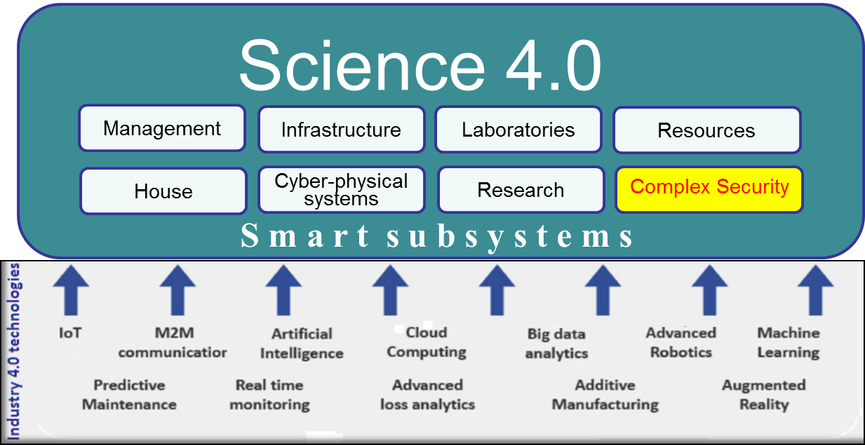
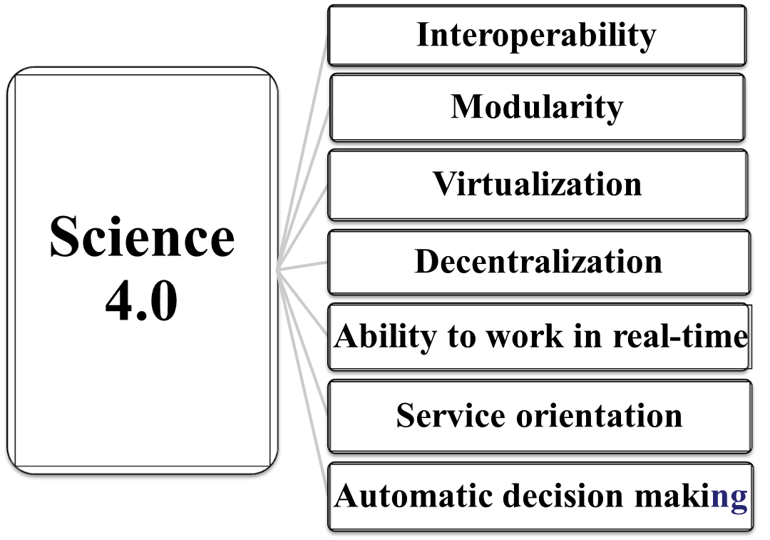
Science 4.0: Complex security problems and solution mechanisms
Tahmasib Fataliyev and Nargiz Verdiyeva
Institute Information Technology ANAS, Baku, Azerbaijan
depart3@iit.science.az
Abstract
Conceptual model of Science 4.
It is supposed to consider the conceptual issues of the reconstruction of science as a corporate environment of Science 4.0 based on the key technologies of Industry 4.0 - Internet of Things, Cyber-Physical Systems, Artificial Intelligence, Cloud computing, Big Data analytics and other Smart solutions; eScience considered to be the technological base of Science 4.0; research of complex security problems and their solution mechanisms within Science 4.0.
Relevance
Introduction
Science and industrial revolutions are intertwined. Their development and formation take place in parallel.
The industrialization process went through a series of stages called industrial revolutions. Mechanization, electrification and informatization were the main trends of the first three industrial revolutions.
The fourth industrial revolution, now known as Industry 4.0, in addition to other areas, opens up new prospects for the development of science. The application of its key technologies, such as IoT, CPS, AI, Cloud computing, Big data analytics in the scientific environment actualizes the implementation of the concept of Science 4.0.
Science 4.0 is a complex corporate system based on interconnected smart applications. Its formation in a new capacity develops scientific activity and science management.
In the design process of Science 4.0, integrated security comes to the fore, along with financial, regulatory, technical and technological challenges
Key features of the Science 4.0 concept
A high degree of interaction of its constituent smart objects,
Generating Big data and integrating these objects with Big data analytics,
Smart objects can be dynamically reconfigured for high flexibility,
Big data analytics can provide global feedback and coordination for high performance.
Thus, this will effectively solve problems within the framework of Science 4.0.
Generalized architecture of Science 4.0
Evolution of science and industrial revolutions
Cybersecurity risk groups
People
Assets
Processes
Technologies
Formation of Science 4.0
Complex security problems
Managing of security, safety and privacy;
Building security, uninterrupted power supply, climate control, video surveillance, access control;
Cybersecurity of networks, Data Centers, ICS, resources, tools and equipment;
Data privacy. Protection of personal information;
Compliance with GDPR;
Monitoring and auditing;
Security of science information support infrastructure . . .
Solution mechanisms
Legal framework and regulations
Trust Center. CERT service
Security policies and procedures
Security audit and reporting
Monitoring, attack modeling, controlled DDoS testing, etc.
Cybersecurity awareness among employees
Employee cybersecurity training
Cooperation with domestic and international organizations . . ..
Principles of formation of Science 4.0

