Slide 1
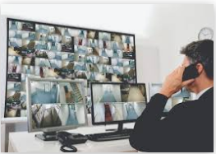
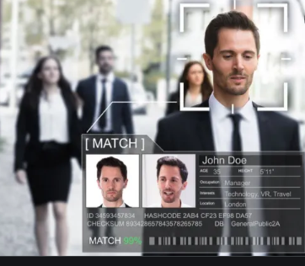
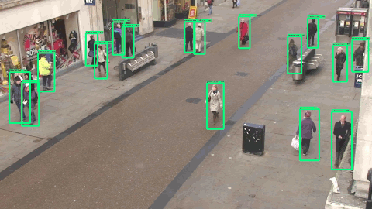
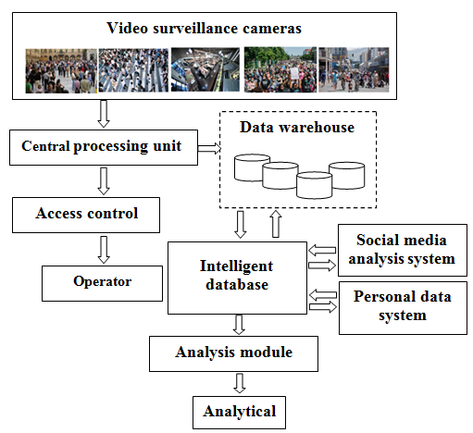
On one approach for detecting social relationships by analyzing video images in e-government
Irada Alakbarova
Institute Information Technology ANAS, Baku, Azerbaijan
airada.09@gmail.com
Abstract
Identification and situation analysis
In the modern world, video surveillance (CCTV) cameras are installed in all areas where it is important to strengthen security: in healthcare, education, sports and many other areas.
The widespread use of CCTV cameras in industry, agriculture, urban infrastructure has led to the continuous collection of various types of data that create "big data“ [1,2] .
The fact that the information collected from CCTV cameras is big data and most of it is not structured makes it relevant to use artificial intelligence and big data technologies in the analysis of this data [3]. The purpose of this article is to develop an architectural diagram of an intelligent video surveillance system.
The main purpose of the system is to identify certain people in the crowd and to identify social relationships between them. After the objects are recognized, the identities of the individuals are determined from the personal database.
The personal database contains the initial information of the individual (name, surname, address, etc.).
Based on the personal data in the database, the probabilities of the relationship of the people.
Recognition of a person and the people with whom he contacts allows the system to form a certain image of a person.
The system can determine the type of relationship between x and y based on age, date of birth, place of residence, and other personal information.
If there is no information about these people in the database, then this means:
or the system made mistakes in recognizing the person,
or information about this person was not entered into the database (illegally crossed the border, etc.).
Introduction
Intelligent video surveillance systems (IVSS) are capable of warning, detecting and identifying alarming situations and abnormal actions, including terrorism, theft, violence, vandalism and other incidents.
IVSS is a system in which its main operational function is to recognize what is happening or has just happened. These automated systems use technology to process video images without human intervention. Research in the world shows that a neural network [4,5], support vector machine [6,7], genetic algorithm [8], fuzzy technology are widely used in the analysis of data obtained from CCTV cameras.
When using big data, it is necessary to take into account the risks of error in the selection, measurement and result obtained [9, 10].
Intelligent video surveillance systems belong to cyber-physical systems and the security of these systems depends primarily on the rules of metadata and on the operation of intelligent services to generate metadata. The rule of metadata is to efficiently index very large video surveillance databases and more efficiently unify search and management across distributed or heterogeneous surveillance systems. The system consists of intelligent services for generating metadata for surveillance systems.
The purpose of the analysis is based on information obtained from CCTV cameras as follows:
Determining the number of people in the crowd.
Determining the nature of the crowd.
Detecting an object (person) in a crowd.
Analysis of the behavior of people in a crowd.
Detection of anomalous events in the crowd.
Conclusion
The main feature of IVSS is distributed data processing, which can help us quickly analyze big data. In distributed systems, data is stored and indexed on multiple servers.
The quality of the analysis will depend on the correct distribution of the data. The research results can be used to better manage e-government, protect the safety of citizens, and in many other areas.
Social relationships are a very complex social network, and the discovery of these relationships will open up new opportunities for more effective implementation of e-services in the country. Detecting social relationships with intelligent VMS will allow you to detect social relationships between people, find specific groups and predict events in advance.
Principle of operation the system
Diversity and a large amount of data will allow you to get more accurate results, but it creates problems with processing big data.
IVSS works as follows: :
From video surveillance cameras information is transmitted to the central processor. The more cameras connected, the higher its load.
To take the load off, data is stored and indexed in a data source located on multiple servers. In a data warehouse, data is classified and structured.
Data processing is carried out in an intelligent database, taking into account personal data. Personal data is necessary to obtain complete and reliable information about a person, as well as to determine social relations among people recognized by IVSS.
Database is a full-text database with artificial intelligence algorithms.
The algorithm intelligently manages data based on neural network models in accordance with the request and presents the result to the analyst in a wide range.
References
[1] Couper M. Is the sky falling? New technology, changing media, and the future of surveys // Survey Research Methods, 2013, vol.7, no.3, pp.145–156.
[2] Suthaharan S. Big Data Classification: Problems and Challenges in Network Intrusion Prediction with Machine Learning // Performance Evaluation Review, 2014, vol.41, no.4, pp.70–73.
[3] Ko K.E., Sim K.B. Deep convolutional framework for abnormal behavior detection in a smart surveillance system // Engineering Applications of Artificial Intelligence, 2018, vol.67, pp.226–234.
[4]Christian S., Toshev A., Erhan D. Deep Neural Networks for Object Detection // In Advances in Neural Information Processing Systems, 2013, pp.2553–2561.
[5]Pathak A.R, Pandey M, Rautaray S. Application of deep learning for object detection // Procedia Computer Science, 2018, vol.132, pp.1706–1716.
[6] Haibin Yu., Wenyan J., Zhen Li, Feixiang G., Ding Y., Hong Z., Mingui S. A multisource fusion framework driven by user-defined knowledge for egocentric activity recognition // EURASIP Journal on Advances in Signal Processing, 2019, vol.1, no.14, pp.1–23.
[7] Schebesch K.B., Stecking R. Support vector machines for classifying and describing credit applicants: detecting typical and critical regions // Operations Research Society, 2005, vol.56, no.9, pp.1082–1088.
[8] Voronovsky G.K., Makhotilo K.V., Petrashev S.N., Sergeev S.A., Genetic algorithms, artificial neural networks and virtual reality problems, Kharkov, OSNOVA, 1997, 112p.
[9] Couper M. Is the sky falling? New technology, changing media, and the future of surveys // Survey Research Methods, 2013, vol.7, no.3, pp.145–156.
[10] Suthaharan S. Big Data Classification: Problems and Challenges in Network Intrusion Prediction with Machine Learning // Performance Evaluation Review, 2014, vol.41, no.4, pp.70–73.
Architectural scheme of the intelligent video analysis
system
The proposed architectural scheme provides the following functions:
1. CCTV cameras transmit information to the central processor.
2. Data transferred from the CPU to the warehouse is structured and formatted
3. Data is grouped at the request of the analyst.
4. The analysis module reveals social relationships between objects in each cluster.
5. Social relations are analyzed and reveals the characteristics of social relations (friends, relatives, colleagues, acquaintances, etc.).
Irada Alakbarova
airada.09@gmail.com

